Slide 1
Capstone Project

Slide 2
Business Problem
I explored Long Island city and New York city use segmented and clustered their neighborhoods. Both cities are very diverse and are the financial capitals of their respective countries. In the end I will compare the neighborhoods of the two cities and determine how similar or dissimilar they are. Is New York City more like Long Island city or not。

Slide 3
Data
Neighborhood has a total of 5 boroughs and 306 neighborhoods. In order to segement the neighborhoods and explore them, we will essentially need a dataset that contains the 5 boroughs and the neighborhoods that exist in each borough as well as the the latitude and logitude coordinates of each neighborhood.

Slide 4
Process
In this Project,I will learn convert addresses into their equivalent latitude and longitude values. Also,I will use the Foursquare API to explore neighborhoods in long island，NY. I will use the explore function to get the most common venue categories in each neighborhood, and then use this feature to group the neighborhoods into clusters. I will use the k-means clustering algorithm to complete this task. Finally, you will use the Folium library to visualize the neighborhoods in long island and their emerging clusters.

Slide 5
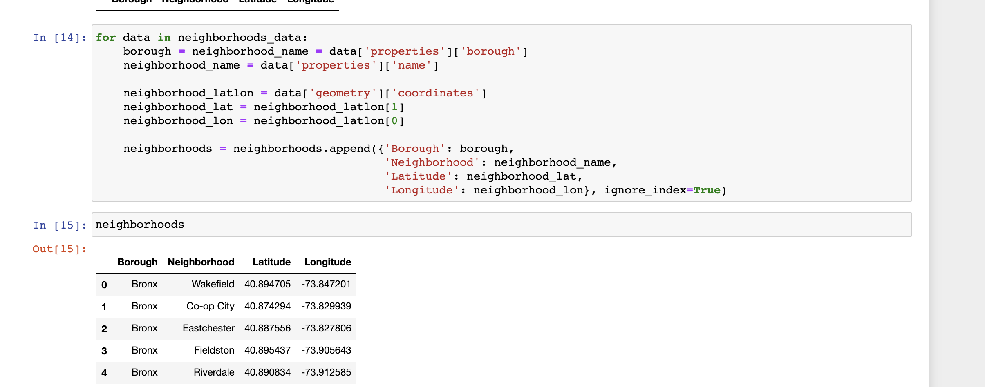
process

Slide 6
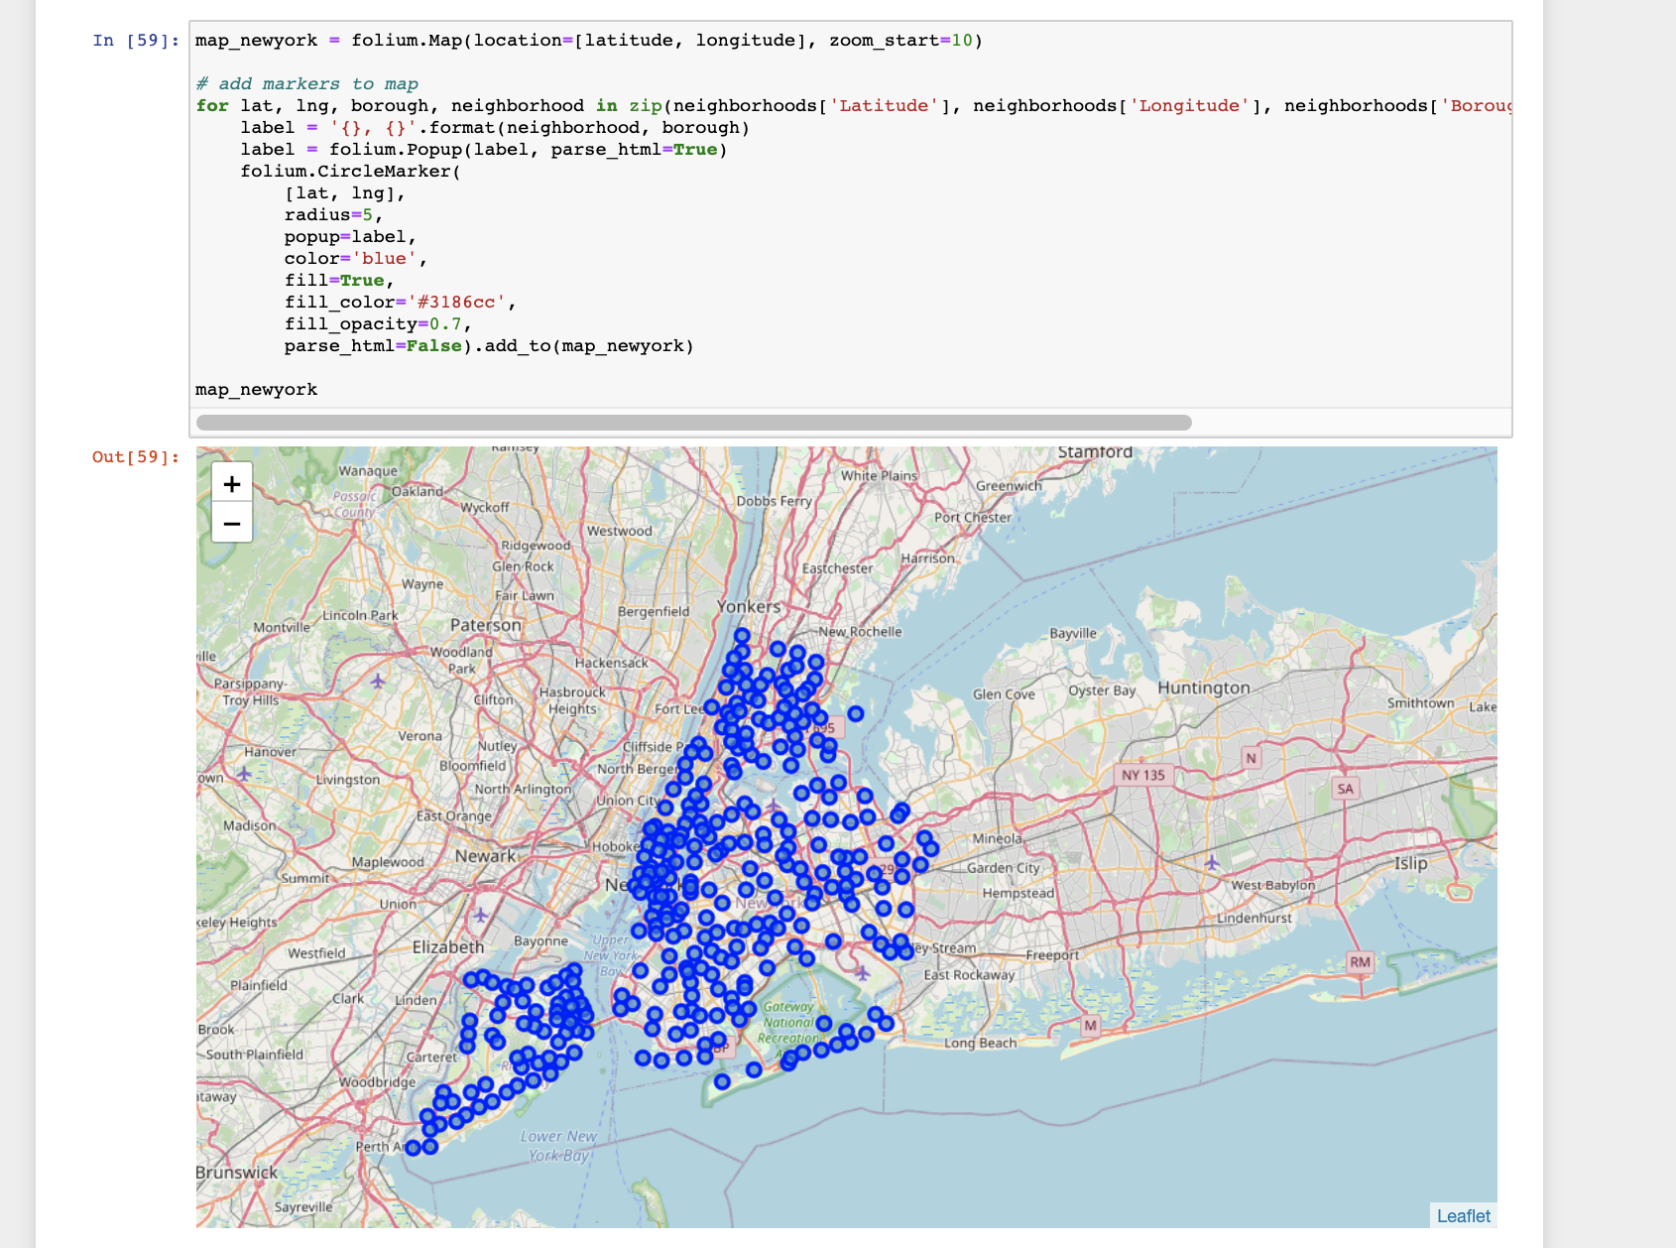
process

Slide 7
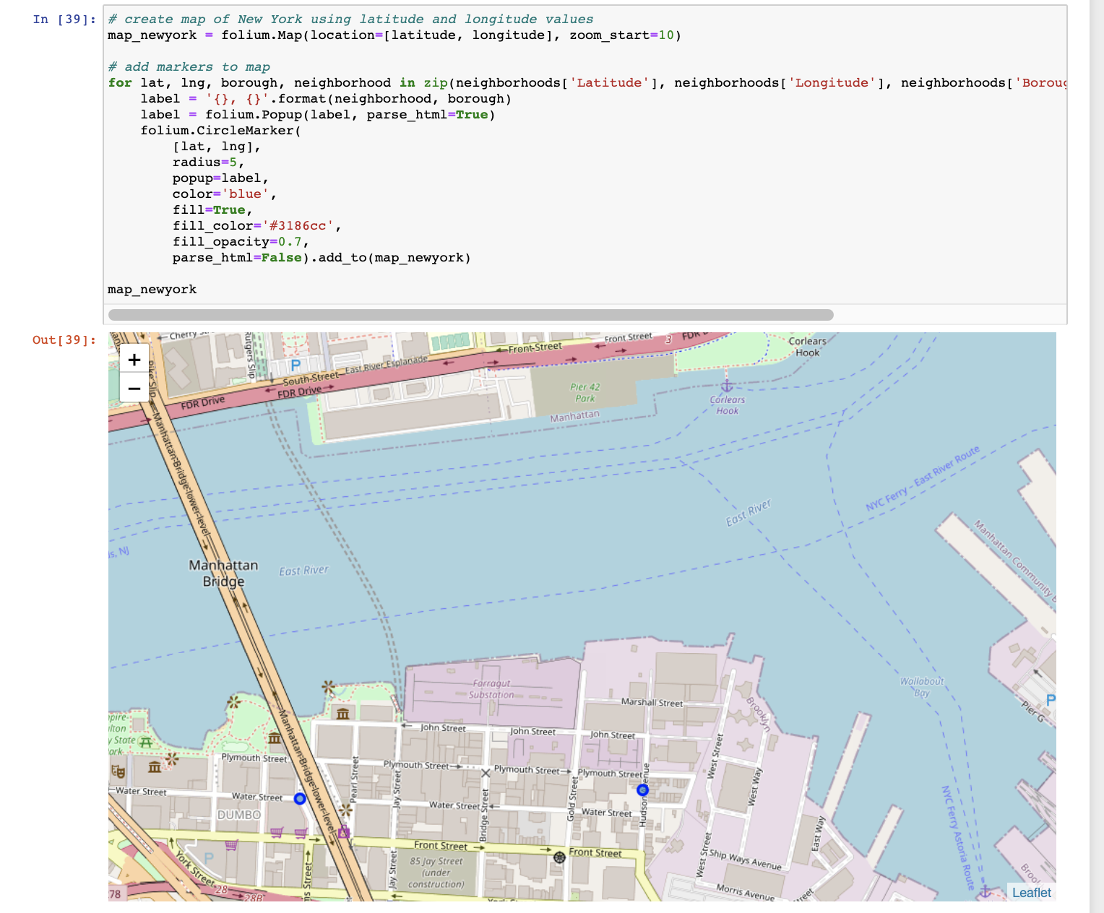
process

Slide 8
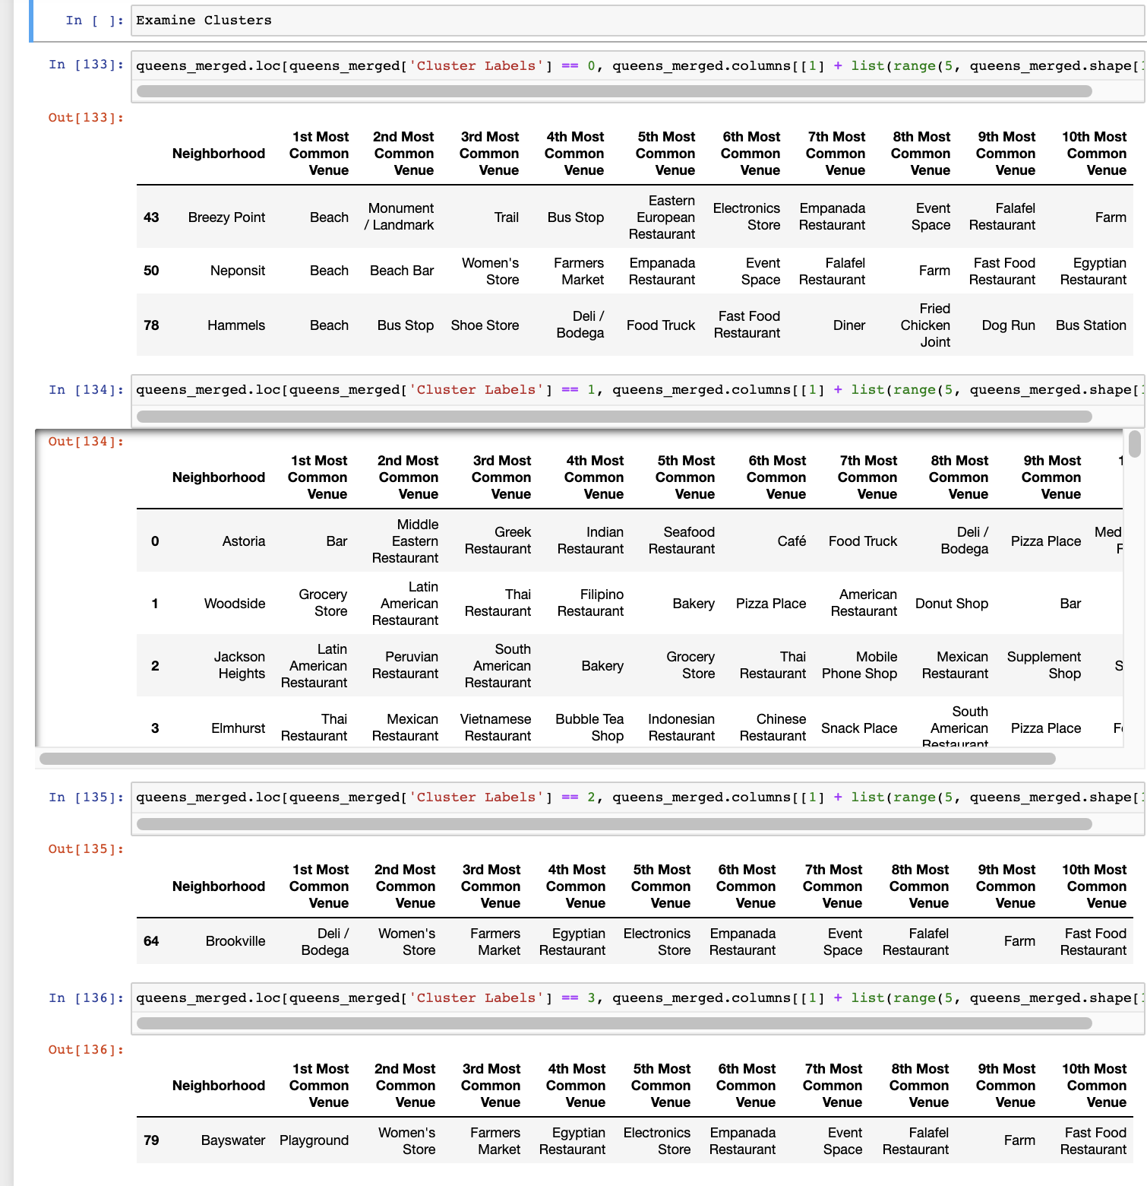
process

Slide 9
END

